Slide 1
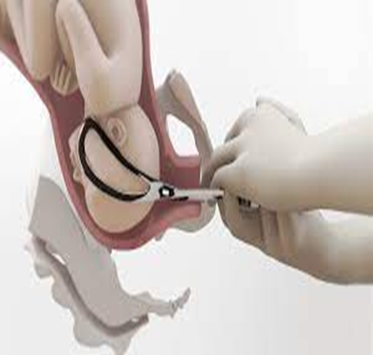
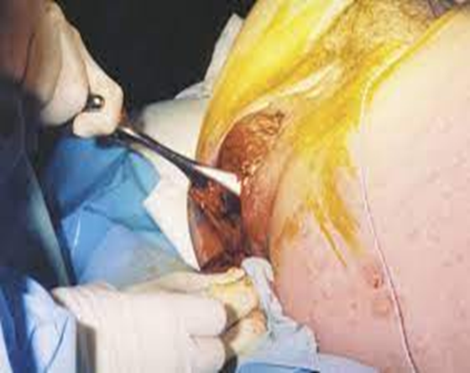
Forceps Delivery

Slide 2
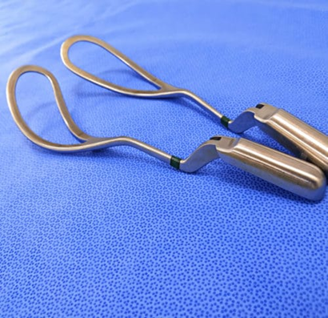
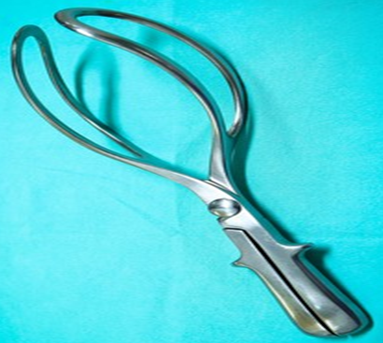
Forceps Delivery
Obstetric forceps are a pair of specially designed instruments used to assist in the extraction of the fetal head, facilitating the delivery of the fetus.

Slide 3
Forceps delivery is employed when it becomes impossible for the mother to complete the delivery through her own efforts.
Additionally, forceps can be used to assist in the delivery of an aftercoming head, breech presentation, or, in some cases, to guide the fetal head upward and out of the pelvis during a cesarean section.

Slide 4
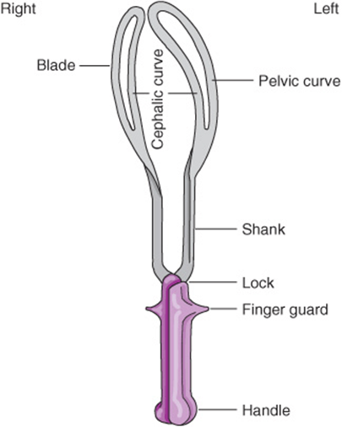
Design of forceps
The design of obstetric forceps comprises two matching metallic halves that articulate at the lock. Each half consists of a blade, shank, lock, shoulder, and handle.
Each blade features two curves – the cephalic curve and the pelvic curve – which conform to the axis of the birth canal. The tip of the blades is referred to as the "toe."
Toe

Slide 5
The concave side of the pelvic curve is the front of the forceps. The blades are designated as the right blade and left blade, corresponding to the side of the maternal pelvis they occupy after application.
The left blade is applied first, ensuring it is clearly positioned against the fetal head, and the right blade is applied subsequently. This process allows the shank of the right blade to engage with and lock onto the shank of the left blade as the handles are brought together.

Slide 6
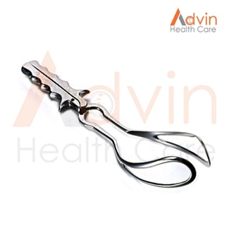
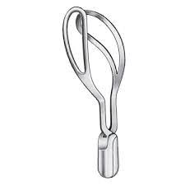
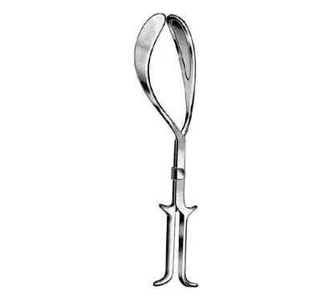
Varieties of obstetric forceps
Long Curved Forceps: These forceps have long shanks and are commonly used in obstetrics.
Wrigley's Short Forceps: These are short-shanked, lightweight forceps with a slight pelvic curve and marked cephalic curve.
Kielland's Forceps: These are long, nearly straight special forceps designed for forceps rotation and delivery, primarily used in occipito-posterior positions.

Slide 7
Indications of forceps delivery
(A) Maternal Indications
Delayed second stage of labour.
Maternal exhaustion or distress.
Pre-eclampsia or eclampsia in the second stage of labour (Pregnancy Induced Hypertension).
Maternal medical disorders such as cardiac disease, severe anemia, TB, to shorten the second stage.
Malposition of the fetal head, such as occipito-posterior or occipito-lateral positions.
Failure of descent or internal rotation for 2 hours in primigravida and 1 hour in multipara.

Slide 8
(B) Fetal Indications
Fetal distress in the second stage of labour.
Cord prolapse in the second stage of labour.
Aftercoming head in breech delivery.
Post-maturity.

Slide 9
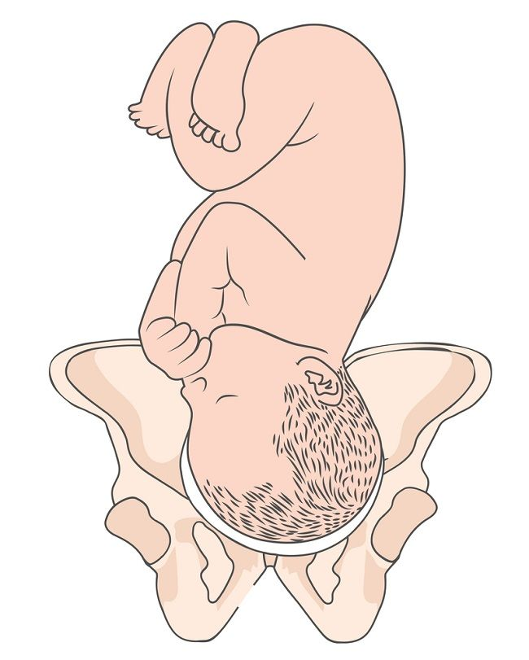
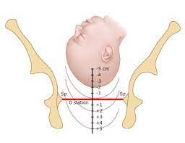
Contraindications to the Use of Forceps:
Absence of a proper indication.
Absence of full cervical dilatation.
Severe cephalopelvic disproportion (CPD) where the fetal head cannot safely pass through the birth canal.
High station of the fetal head, not engaged in the pelvis.
Cessation of uterine contractions, as forceps are typically used during contractions to aid in delivery.

Slide 10
Prerequisites for Forceps application
Certain condition must be satisfied prior to forceps applications
The fetal head must be engaged, flexed, and preferably well-rotated.
There should be no obvious cephalopelvic disproportion (CPD).
The cervix must be fully dilated and effaced.
The amniotic membranes must be absent (ruptured).
The uterus must be contracting.
The bladder must be empty.
The rectum should preferably be empty.
The fetal presentation and position must be suitable.
The baby should be alive.
There should be no undue obstruction.

Slide 11
Procedure and Management:
Explain the purpose of the procedure to the patient and obtain informed consent.
Prepare a sterilized delivery set, episiotomy set, forceps, catheter, emergency medication resuscitation set, suction equipment, and oxygen supply.
Inform the pediatrician and ensure all necessary equipment for neonatal care is ready.
Place the mother in the lithotomy position.
Ensure that the operators are dressed in sterile masks, gowns, and gloves.
Wash the vulva with an antiseptic solution and drape the area. Insert a sterile catheter to empty the bladder. Cont.…

Slide 12
Prepare the setup as you would for a normal delivery.
Infiltrate the perineum and perform an episiotomy when indicated.
Assemble the forceps before application. Ensure that all parts fit together securely, and lubricate the blades of the forceps.
Choose the first left blade, and hold it vertically like a pen with your left hand, directing the cephalic curve toward the vulva. The middle and index fingers of the semi-supinated right hand are introduced into the posterior-lateral aspect of the vagina alongside the fetal head, while keeping the thumb and other fingers outside. Cont..

Slide 13
Gently introduce the left blade between the fetal head and internal fingers, with the convex border of the blade guided upward by the thumb of the vaginal hand.
Follow the same procedure to introduce the right blade.
Lock the blades, and if locking is difficult, apply pressure on the perineum. If further difficulties persist, withdraw the blades and conduct a thorough vaginal examination to check for any malposition of the fetal head.
Cont…

Slide 14
Grip the forceps handles with the right hand and apply traction during a uterine contraction. In a low forceps operation, use a single continuous pull with traction directed downward, downward-forward, and finally upward.
Deliver the fetal head by extension and remove the blades after head delivery.
In case of forceps delivery failure, consider performing a cesarean section (C/S).
Actively manage the third stage of labor following the delivery of the head.
Resuscitate the newborn as needed and promote warmth through skin-to-skin contact.

Slide 15
Dangers of use of forceps
A. Maternal dangers
Soft tissue injuries to cervix, vagina, perineum, and extension of episiotomy.
Rupture of the uterus
Injury to bladder or rectum
Traumatic PPH and shock
Infection
Bladder atony
Fracture of sacro-coccygeal joint
Pelvic haematoma
Cont.………

Slide 16
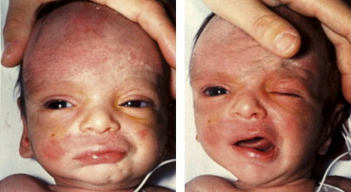
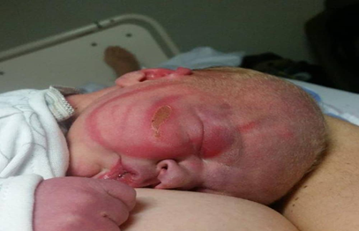
cont.,………
Dangers of use of forceps
B. Fetal dangers
Cephalohaematoma
Fracture skull
Intracranial hemorrhage
Brain damage
Marked depression of respiration and asphyxia
Facial palsy/Brachial palsy
Soft tissue injury to face, bruising and laceration
Infection/convulsion/fetal death
Cord compression.

