Slide 1
PARTOGRAPH
Created by: Sita Pandey

Slide 2
PARTOGRAPH
The partograph functions as a graphical tool to visually monitor the progress of labour, maternal well-being, and the fetal condition throughout the labor and childbirth process.
It comprises a graph that documents the time-based advancement of labour, offering a visual representation.
This tool creates a graphic record reflecting the labour's progression and relevant record of maternal and fetal information.
Cont..

Slide 3
It was initially introduced as an early warning system to detect labour that was not progressing normally.
This early detection facilitates timely transfers to referral centers, enabling potential interventions such as augmentation or cesarean section as needed.
Furthermore, the partograph signifies instances where augmentation is advisable and can even provide indications of potential cephalopelvic disproportion (CPD) before labour complications escalate to obstruction.

Slide 4
Objectives
Early detection of abnormal labour progression.
Prevention of prolonged labour.
Recognition of cephalopelvic disproportion.
Assistance in making timely decisions regarding the transfer, augmentation, or termination of labour.
Enhancement of the quality and consistency of observations made on both the mother and fetus.
Early identification of maternal and fetal issues.
Effective reduction of complications stemming from prolonged labour.

Slide 5
Advantages
The advantages of using a partograph include:
Comprehensive documentation: All essential information is consolidated onto a single sheet or paper, facilitating easy maintenance and detailed interval notes.
Efficiency in recording: There's no requirement for repetitive recording of labour events, streamlining the documentation process.
Early deviation detection: The partograph can promptly predict deviations from the normal labour duration, enabling early intervention.
Cont..

Slide 6
Clear and objective records: The records are clear and objective, enabling both nursing and medical personnel to quickly assess the labour progress for each patient.
Consistent hand-over: The partograph aids in consistent staff hand-over procedures.
Reduction in complications: It contributes to the reduction of prolonged labour and the need for cesarean section, thereby ultimately decreasing maternal and fetal morbidity.

Slide 7
Indications
Labour management: A partograph is specifically designed for labour management purposes.
Universal application: It should be employed for labour cases, ensuring consistent monitoring.
Atypical labour scenarios: It is particularly valuable when dealing with labour situations that are anticipated to deviate from the norm, such as suspected cephalopelvic disproportion.
Cont..

Slide 8
4. Pregnancy complications: Prior to using a partograph, it is essential to assess for any pregnancy complications that necessitate immediate action.
By adhering to these indications, the partograph can effectively contribute to proper labour monitoring, management, and timely decision-making.

Slide 9
Contraindication for using partograph
  Antepartum hemorrhage
  Diagnosed Cephalo Pelvic Disproportion (CPD)
  Severe pre-eclampsia and eclampsia
  Fetal distress
  Anemia (severe)
  Multiple pregnancy
  Mal-presentation
  Premature labour
  Obstructed labour

Slide 10
Principles
The active phase of labour is initiated when cervical dilatation reaches 4 cm.
The latent phase of labour should ideally conclude within 8 hours.
During active labour, the rate of cervical dilatation should not fall below 1 cm per hour.
Cont...

Slide 11
Interventions should be considered after a slowing of labour, with a minimum of 4 hours' delay. This approach safeguards both the mother and fetus while avoiding unnecessary interventions.
Vaginal examinations should be conducted as infrequently as possible while maintaining safe practice, typically recommended every 4 hours.

Slide 12
Components of partograph
Woman’s identification
Fetal condition (at the top of the partograph)
Fetal heart recording
Amniotic membrane
Moulding
Progress of labour
Descend of the head
Cervical dilatation
Uterine contraction
Oxytocin drip
Drugs and other intravenous fluid
Maternal condition
Vital signs
Urine analysis

Slide 13
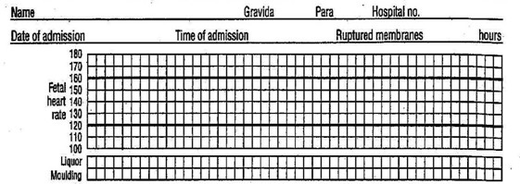
Woman’s information
Fill out name, age, gravida, para, hospital number, date and time of admission and time of ruptured membranes hour is written at the top of the graph

Slide 14
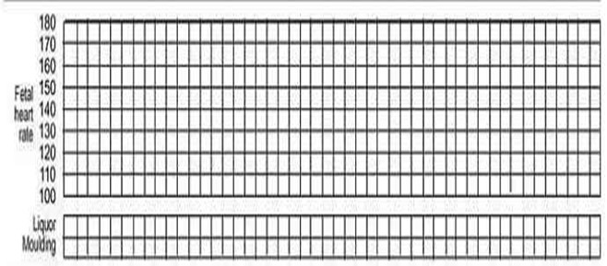
Fetal condition
This part of the graph is used to monitor and assess fetal condition
Fetal heart rate
Liquor (amniotic fluid)
Moulding the fetal skull bones

Slide 15
The following observation are recorded on the partograph immediately below the fetal heart rate
It membranes are not ruptured record letter “I” for intact.
If membranes are ruptured liquor is clear, record letter “C” (clear)
If amniotic fluid is blood stained record letter “B” (blood)
If amniotic fluid is green, greenish yellow in color (meconium stained) record letter “M” (meconium)
If amniotic fluid is absent record letter “A” (absent)

Slide 16
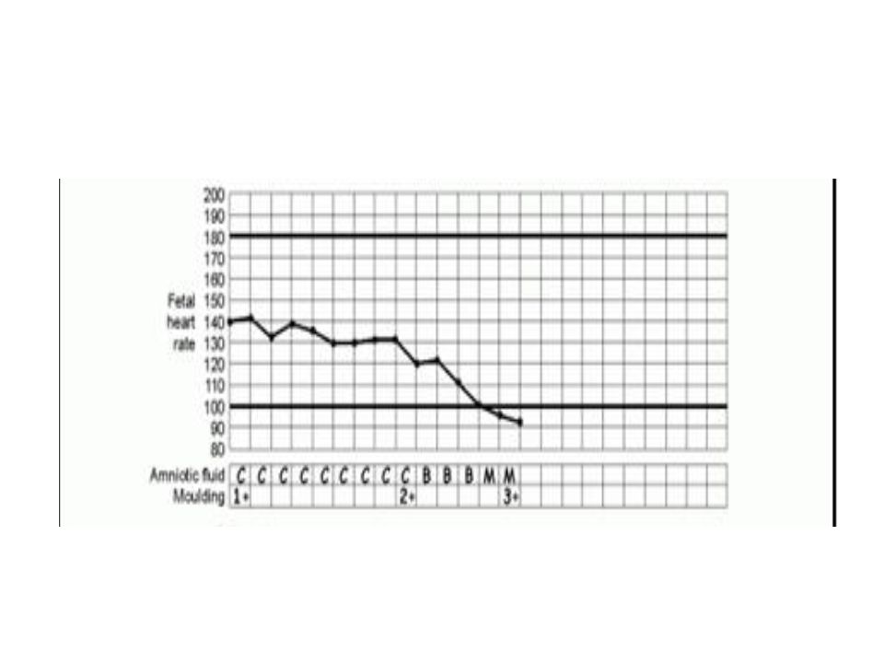

Slide 17
Fetal Heart Rate (FHR)
FHR is recorded at the top of the partograph and record every ½ hour. The FHR indicates the state of fetus inside the uterus. Observation of the FHR is a safe and reliable clinical way of knowing that the fetus is well. Each square in the graph indicates ½ hour and fetal heart is recorded every ½ hour and count for 1 min. Average base line rate should be between 100-180 beats/min.
Cont..

Slide 18
Plot one dot (•) in the line at the level of the FHR indicated in figure on left side. If the heart rate remains abnormal (ᛎ100 or ᛏ 180 beats/min), take action immediately.
Observe and record the color of amniotic fluid at every vaginal examination. Normally the amniotic sac contains whitish watery fluid, occasionally with flakes of vernix caceosa.

Slide 19
Determining whether the membranes have ruptured or not;
Intact membranes feel like a slippery membrane over the fetal presenting part.
If the membranes are bulging, like a slippery, fluid filled balloon over the presenting part. It may be difficult to feel the fetal presentation clearly if membranes are bulging tensely.
If the membranes have ruptured, fluid will often drain from vagina.

Slide 20
Moulding of the fetal skull bones
Moulding is important indication of how adequately pelvis can accommodate the fetal head. Increasing moulding with the head high in the pelvis is an ominous sign of CPD. The moulding, look at using following key.
1 = Bones are separated and sutures can felt easily.
1+ =Bones are touching each other (suture apposed)
Cont..

Slide 21
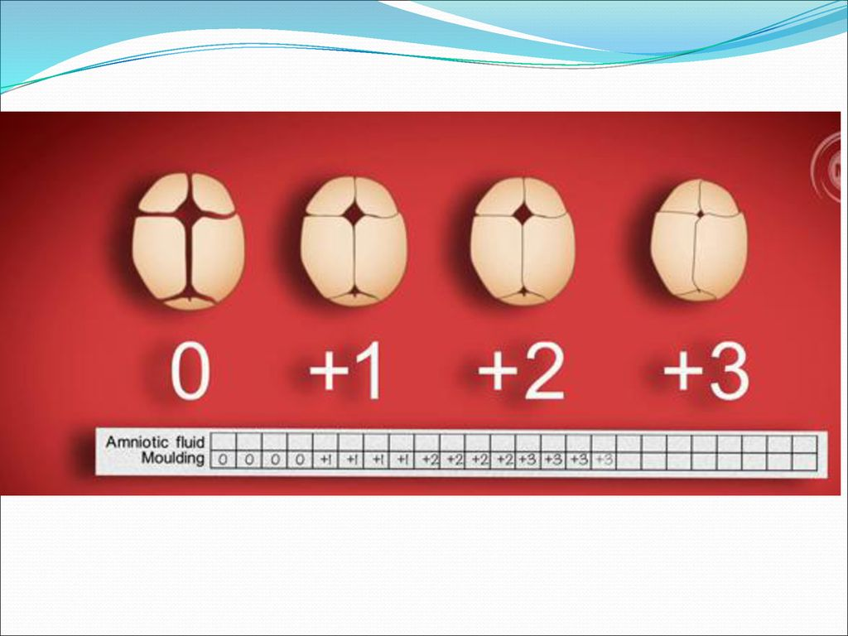
2+ =Bones are overlapping but can be separated easily with pressure from finger (suture overlapped but reducible)
3+ =Bones are overlapped severely cannot be separately easily with pressure from examiner finger (suture overlapped and not reducible)
Record of the moulding of the fetal skull bones at every vaginal examination and marked with +1, +2, +3.

Slide 22
Progress of labour
Progress of labour (at middle) this part of the graph is used to monitor progress of labour. Following three points give information about the progress of labour.
Cervical dilatation
Descent of the fetal head
Uterine contraction

Slide 23
Cervical Dilatation
Assessed at every vaginal examination and marked with a cross (X). Being plotting on the partograph at 4 cm. The crosses (X) in the graph are joined by a continuous line. The climbing tendency of this line normally lies to the left of the middle of the graph.

Slide 24
Alert line: A line starts at 4 cm of cervical dilatation to the point of expected full dilatation at the rate of 1 cm per hour. Alert line is the active stage of labour, plotting of the cervical dilatation will normally remain on or to the left of the alert line. When dilatation crosses to the right of the alert line, this is a warning sign that labour may be prolonged. When the dilatation moves to the right of the alert line, the mother must be transferred to a hospital.

Slide 25
Action line (Hospital line) is parallel and 4 hours to the right of the alert line. This is the critical line at which specific management decisions must be made at the hospital, if a woman’s reaches the action line, a decision must be made about the causes of the show progress and action need to be taken.
Cont..

Slide 26
This decision as to what action to take to assist labour must be made with a doctor, preferably in a hospital, if not already performed Artificial Ruptured of Membrane and oxytocin augmentation, C/S or vacuum delivery.

Slide 27
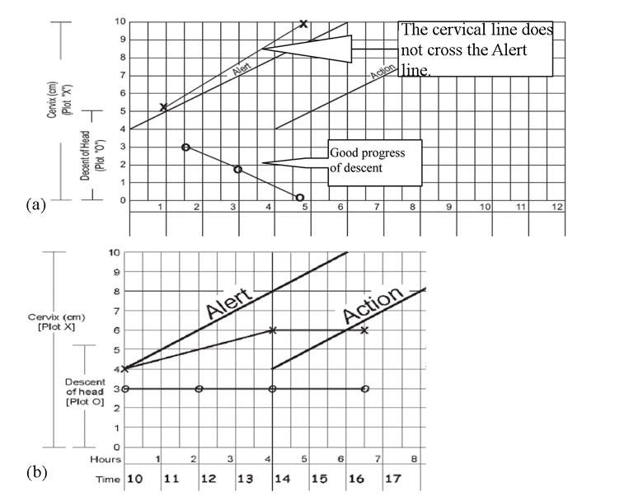

Slide 28
Descent of the fetal head
Descent of the fetal head is measured in number of fingers when abdominal palpated. It refers to the part of the head palpable above the symphysis pubis, recorded as a circle (0) at every abdominal examination
A head that is entirely above the symphysis pubis is 5/5 palpable. Head mobile above the symphysis pubis
A head accommodates two finger above the symphysis pubis is 2/5
A head that is entirely below the symphysis pubis or sinciput is at level of symphysis pubis is 0/5 palpable

Slide 29
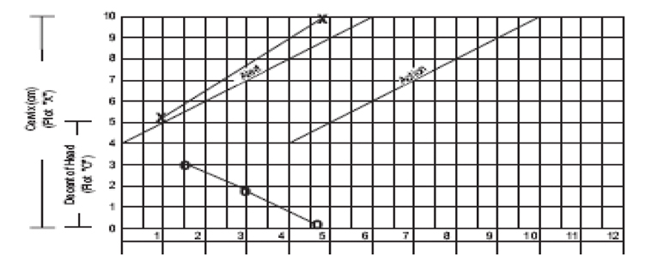

Slide 30
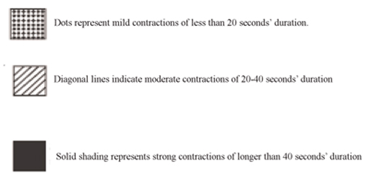
Uterine contraction
Assess the frequency, duration and intensity of uterine contractions every 30 min. by direct palpation. Chart every ½ hour count the number of contractions in a 10 min. time period and their duration in sec. Shadow the duration of contraction as given below

Slide 31
Duration of contraction
Duration of the contraction is from the time the contraction is first filled abdominally to the time when the contraction passes off, and measures in second.

Slide 32
Frequency of contraction
It is time of interval from the beginning of one contraction to be beginning of the next contraction. The frequency usually recorded in min. Number assesses frequency of contraction in 10 min period.
The frequency, duration and intensity of uterine contraction can be estimated by palpation.
Cont..

Slide 33
The tension in the uterine muscle between contraction relaxation of the uterus felt on palpation
Mild
Moderate
Strong
Hours: time elapsed since the onset of active phase of labour
Time: record actual time of day at hourly interval.

Slide 34
Maternal condition
Maternal condition (at bottom), this part of the graph is used to monitor maternal condition. All the observation for the mother’s condition is written at the bottom paragraph
Oxytocin: record the amount of oxytocin per volume IV fluids in drops per minutes every 30 minute when used. In oxytocin drip line consists of two lines, one for the recording of amount of oxytocin per liter of IV fluid and other one is for drop of fluid per minute.
Cont……

Slide 35
Drugs given: record any additional drugs given. This includes sedatives, antibiotics and IV fluid.
Pulse: record every 30 min. and mark with a dot (᛫)
Blood pressure: record every 4 hour and mark with arrows (ᛨ)
Temperature: record every 2 hours.
Protein, Acetone, and Volume: Record when urine is passed. Encouraged to pass urine every 2 hrs in labour.
Record the delivery details to the right of the action line
Types of delivery
Date and time of delivery
Birth weight of baby

Slide 36
