Slide 1
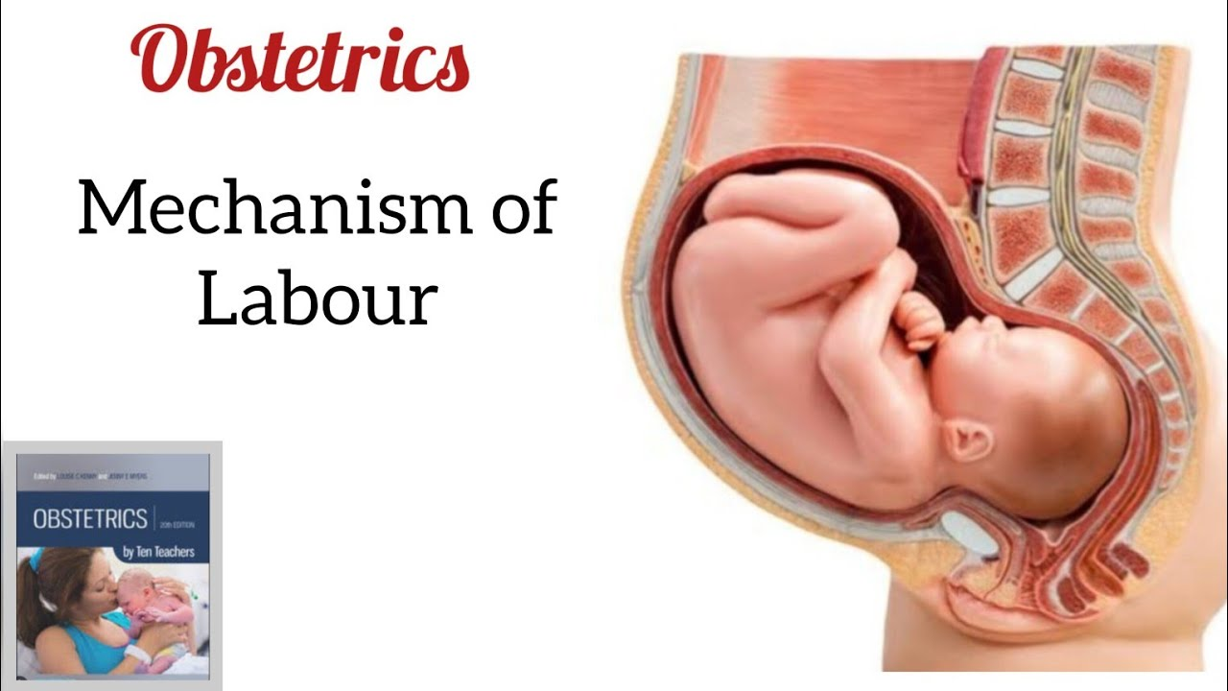
Mechanism of labour

Slide 2
Mechanism of labour
The series of movements that take place within the head during its passage through the narrow, elongated, and twisted birth canal and pelvis is called mechanism of labour.

Slide 3
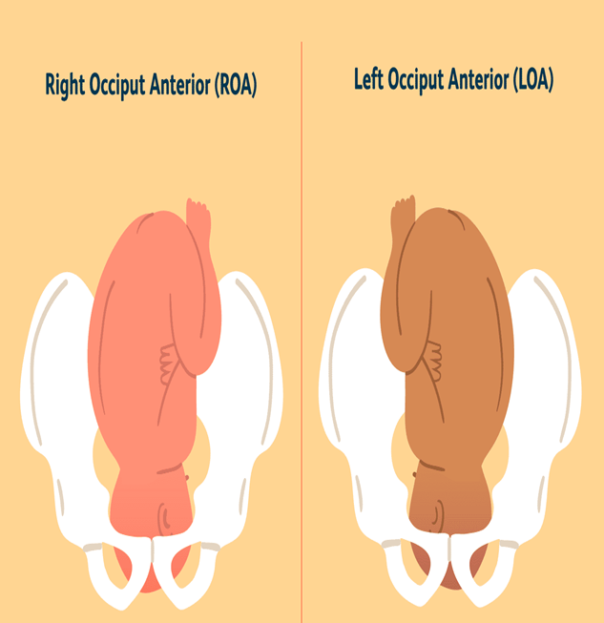
In normal labour, the vertex presentation is either in the Left Occiput Anterior (LOA) or Right Occiput Anterior (ROA) positions. LOA is slightly less common than the ROA position. The head primarily enters the pelvic brim through the most frequently available transverse diameter, which constitutes the longest diameter of the pelvis (about 70% of cases).
.

Slide 4
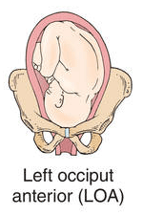
For normal mechanism the fetus should be on following condition.
Lie- longitudinal
Attitude- well flexed
Presentation- vertex or cephalic
Position- left occipito anterior
Denominator- occiput
Presenting part- posterior area of right parietal bone or sub occipital part.
Engagement- head should be well engaged in pelvic brim and cavity
Station- below the ischial spines

Slide 5
As the left occipito-anterior and occipito-lateral are the commonest position, mechanism of labour are as follows.
Engagement
Descent
Flexion
Internal rotation of the head
Crowning of the head
Extension of the head
Restitution of the head
Internal rotation of the shoulder
External rotation of the head
Lateral flexion of the body with expulsion of the fetus

Slide 6
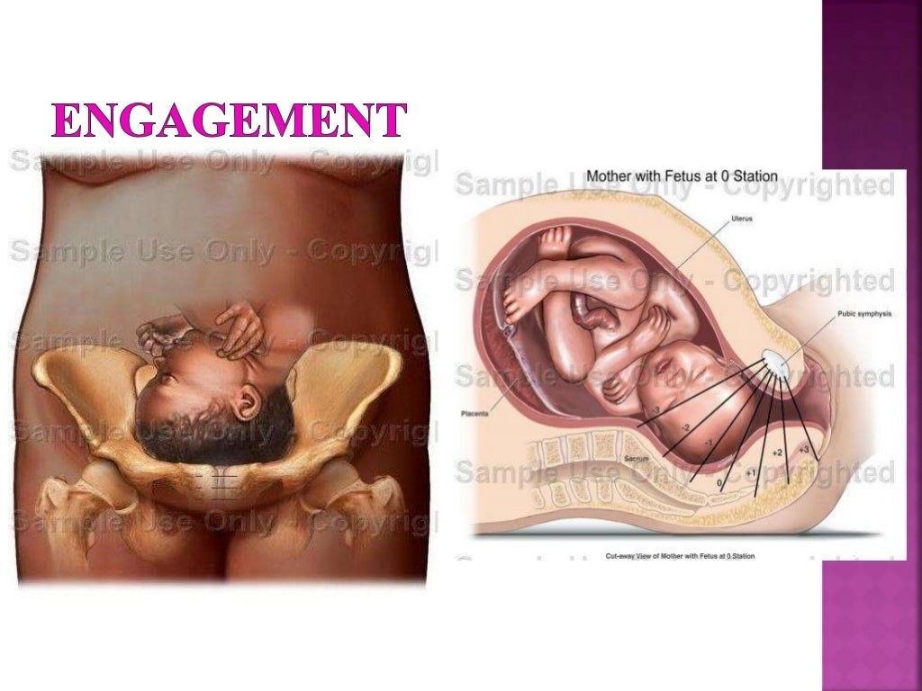
1. Engagement
In LOA fetal enters pelvic brim with occiput (denominator) lying in relation to left iliopectineal eminence, sinciput at right sacroiliac joint and sagittal suture lying on right oblique diameter of maternal pelvis. The engaging transverse diameter of fetal head is biparital 9.5 cm. Both diameter remains on the same plane. In primigravida, engagement occurs before the onset of labour. In multigravida same may occur in late 1st stage with rupture of membranes Cont..

Slide 7
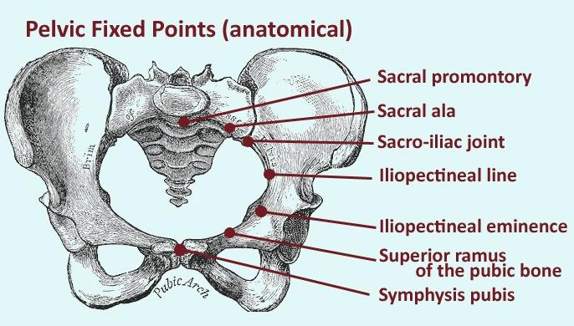

Slide 8
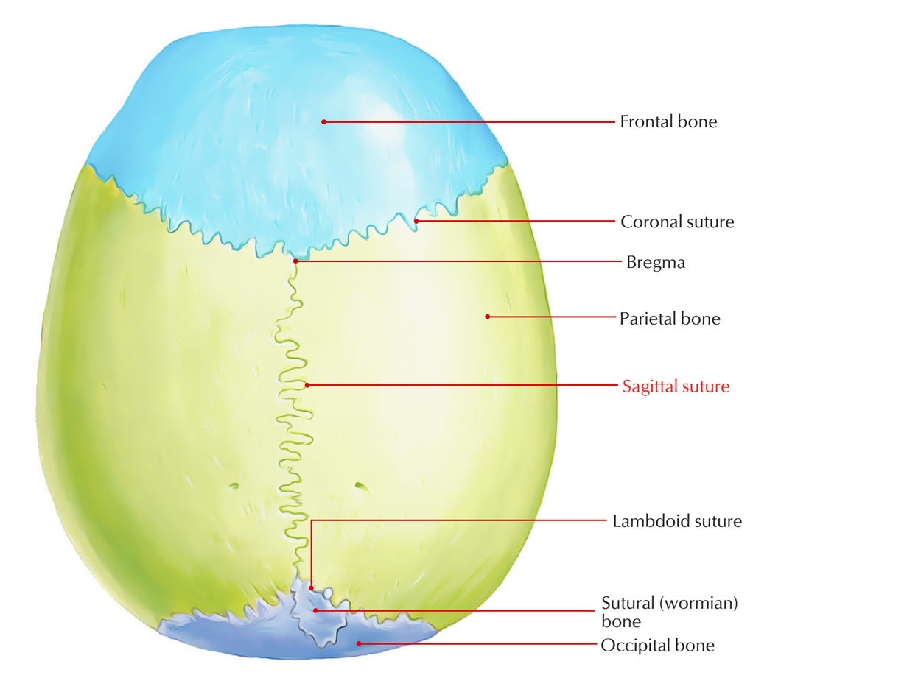

Slide 9
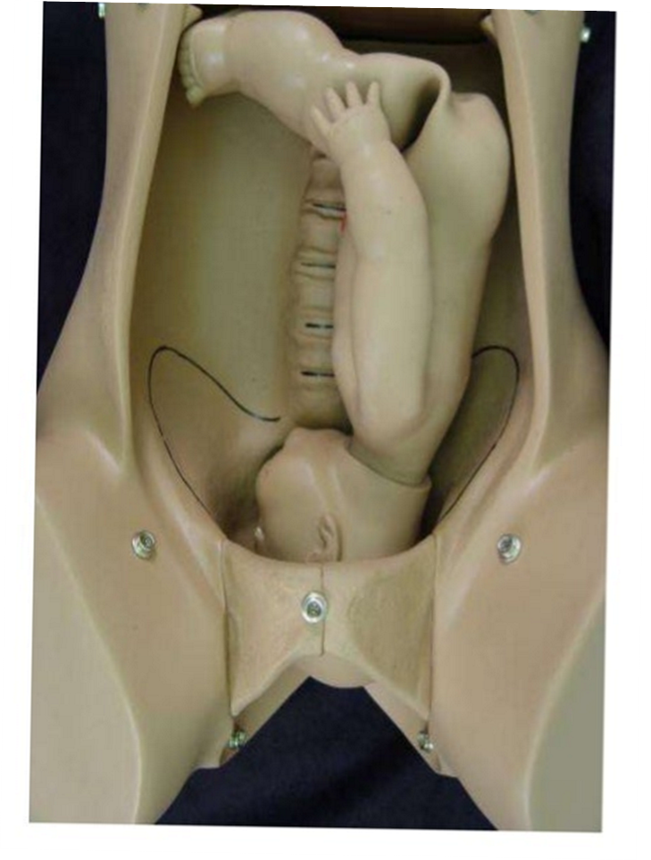
2. Descent
Descent is a continuous process. It is slow or insignificant in 1st stage but pronounced in 2nd stage. It is completed with expulsion of fetus, descent of fetal head often begins before onset of labour. In primigravida, occur during later weeks of pregnancy, & in multipara may not occur until labour actually begin. During 2nd stage, descent is more rapid because the abdominal muscle and diaphragm come into play and fetus being actively expelled.

Slide 10
Factors facilitating descent are:
Uterine contraction and retraction
Bearing down effort by woman
Straightening of the fetal ovoid head specially after rupture of membrane and full dilatation of the cervix

Slide 11
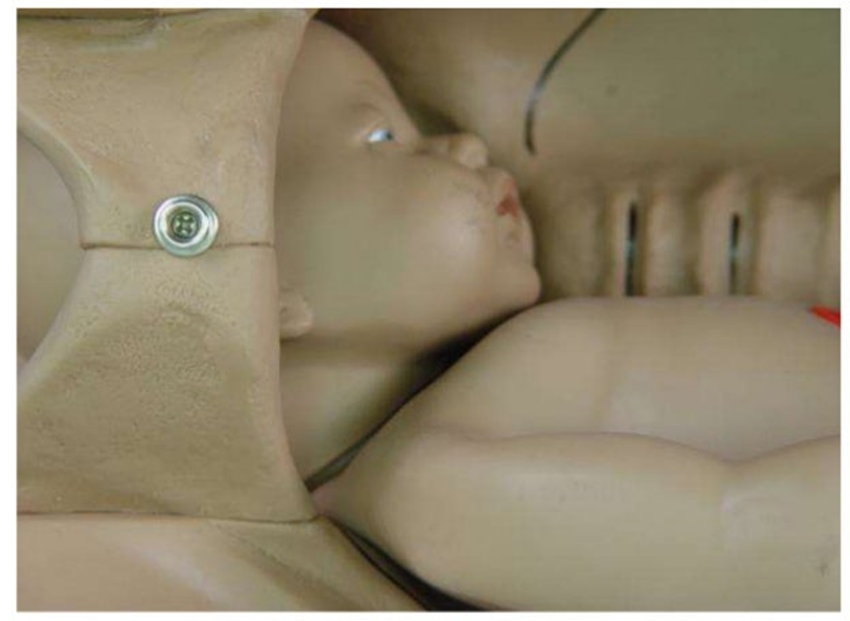
3. Flexion
The head is usually flexed at beginning of the labour and increases throughout labour. Fetal spine is attached nearer the posterior part of the skull; pressure exerted down the fetal axis will be more forcibly transmitted to the occiput than sinciput. The effect is to increase flexion results in smaller presenting diameters negotiate pelvic more easily. At the onset of labour sub occiputo-frontal diameter 10 cm is presenting part, with greater flexion the sub- occiputo bregmatic diameter 9.5 cm become the leading part.
As the head meets the resistance of the birth canal during descent, full flexion achieved. If pelvis is adequate, flexion is achieve either due to the resistance offered by unfolding cervix, walls of the pelvis or by the pelvic floor.

Slide 12
4. Internal rotation of the head
Internal rotation is turning forwards of whatever part of the fetus reaches the anterior, lateral half of the gutter shaped pelvic floor first. During a contraction the leading part is driven downwards onto the pelvic floor. The resistance of this muscular diaphragm brings about rotation. As the contraction fades, the pelvic floor muscle rebounds causing the occiput to gride forwards. Resistance is therefore an important determinant of rotation. The slop of the pelvic floor determines the direction of rotation. In a well flexed vertex presentation, the occiput leads and meets the pelvic floor first and rotates anteriorly through 1/8th of a circle.

Slide 13
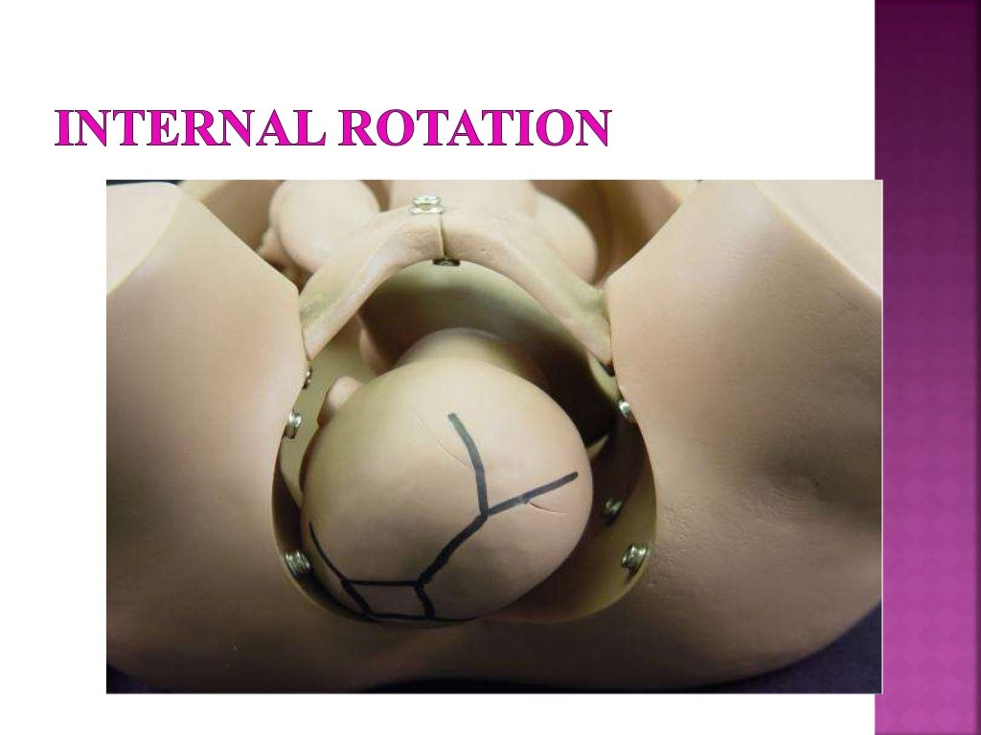
In LOA position, occiput rotates 1/8th (45 degree) from the left towards midline where it can escape under the pubic arch and allow the sub-occipital region to pivot on the lower border of the symphysis pubis. This causes a slight twists on the neck of the fetus as the head is no longer in direct alignment with the widest (anterior posterior) diameter of the pelvic outlet facilitating on easy escape. The occiput slope beneath the sub-pubic arch and crowning occurs. When the head no longer recedes between contractions and the widest transverse diameter (biparital) is born.

Slide 14
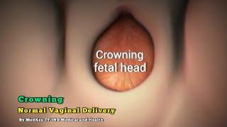
5. Crowning of the head
After internal rotation of the head, further descent occurs until the sub-occiput lies underneath the pubic arch. As this stage, the maximum diameters of the head (biparital) stretches the vulval outlet without any recession of the head even after the contraction is over called crowning of the head.

Slide 15
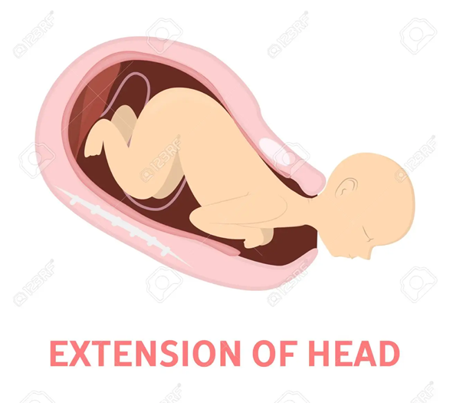
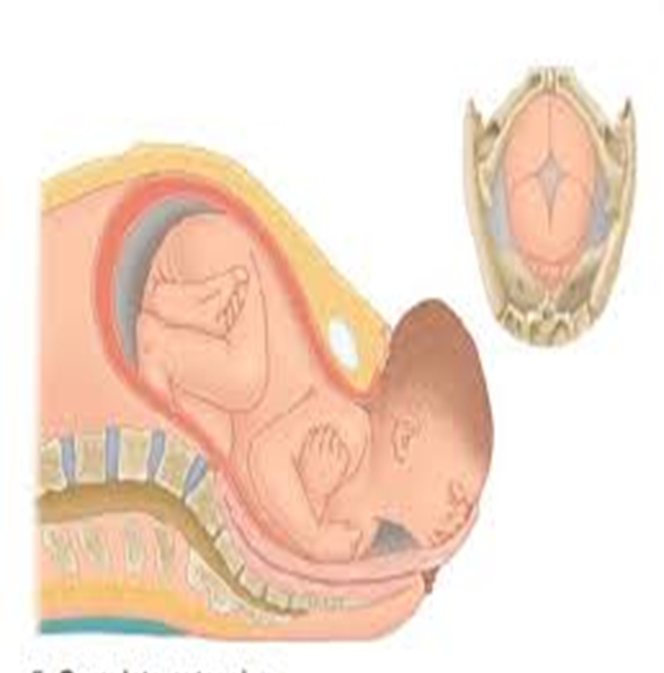
6. Extension of the head
Delivery of the head takes place by extension through ‘ couple of force’ theory. The driving force pushes the head in a downward direction while the pelvic floor offers a resistance in the upward and forward direction, the downward and upward forces neutralize and remaining forward thrust helping in extension. This release sinciput, face and chin which, sweep the perineum. The sub-occiputo frontal diameter 10 cm distends the vaginal outlet.

Slide 16
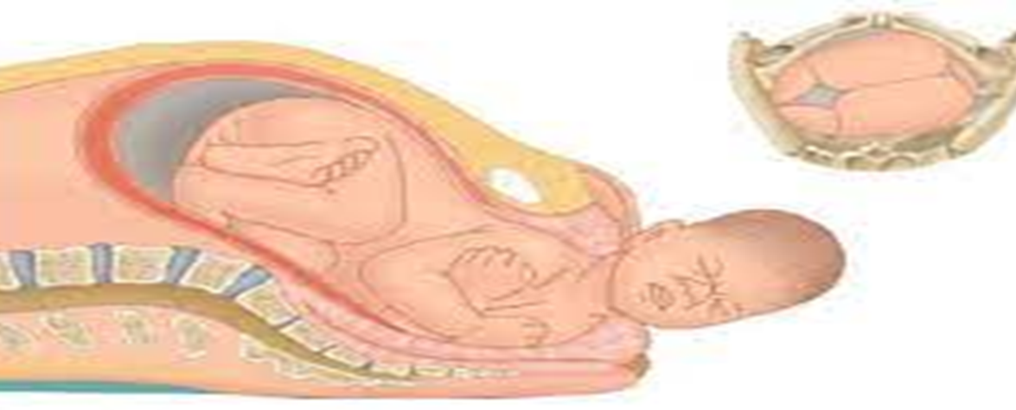
7. Restitution of the head
In the visible passive movements of the head to undo the twist in the neck, that took place during internal rotation of the head. In a vertex, LOA, the occiput resituates 1/8th of the circle to the left, back to where it was before internal rotation took place. The occiput thus points to the maternal thigh of the corresponding side to which it originally lay.

Slide 17
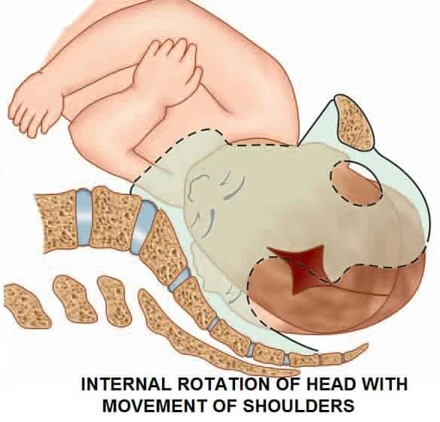
8. Internal rotation of the shoulders
This is a movement similar to internal rotation of the head. The shoulder in LOA are in the left oblique diameter of the pelvic floor and rotates forwards bringing the shoulders into the antero-posterior diameter of the outlet. This should take place with the uterine contraction which occurs after the head has been born

Slide 18
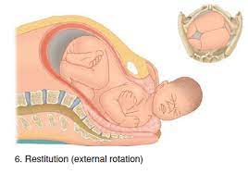
9. External rotation of the head
A movement of rotation of the visible externally due to internal rotation of the shoulders. As the anterior shoulder rotates towards the symphysis pubis for the oblique diameter, it carries the head in a movement of external rotation through 1/8th of a circle in a same direction as restitution. The shoulders now lie in AP diameter. The occiput points directly towards the maternal thigh corresponding to the side to which it originally directed at the time of engagement. It is a separate movement from restitution and should be allowed to occur before the shoulders are born.

Slide 19
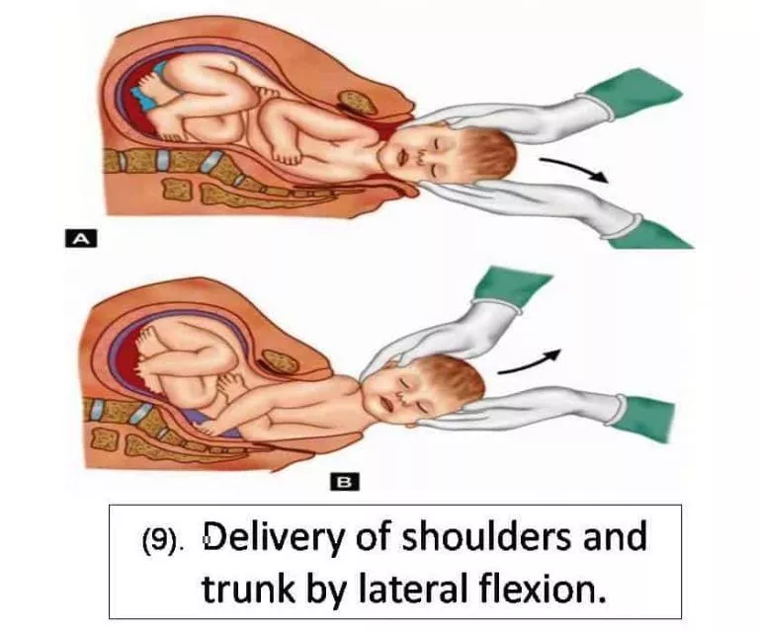
10. Lateral flexion of the body
A side ways bending of the spine, which takes place while the body is being expelled, so that it confirms to the curve of the birth canal. The shoulders are born sequentially, usually anterior shoulder first. Anterior shoulder slips beneath the sub-pubic arch and the posterior shoulder passes over the perineum. This enables a smaller diameter to distend the vaginal orifice then of both shoulder were born simultaneously. The reminder of the body is born by lateral flexion as the spine bends side way through the curved birth canal.

