Slide 1
Management of second stage of labour

Slide 2
Introduction
The onset of the second stage of labour is defined as the point at which the cervix is fully dilated and to end with the expulsion of the fetus from the birth canal. Consequently, the duration of the second stage is determined by the medical or midwifery professionals' diagnosis of complete cervical dilation in the woman.

Slide 3
Objectives
To ensure the birth of a live and healthy baby
To provide comprehensive care to mother and baby
To prevent injury to both baby and mother
To prevent complications
To identify earlier and prompt management of complications

Slide 4
Principles
The principles guiding the care during the second stage of labour encompass;
The application of infection prevention measures for the well-being of both mother and baby,
Diligent and vigilant monitoring of mother and baby’s conditions and labour progress,
Maintaining a constant presence and support for women in labour,
Cont.…

Slide 5
Offering consistent emotional and physical comfort to the mother,
Proactively anticipating the stages and mechanisms of normal childbirth,
Facilitate woman for the natural birthing process,
Minimizing the need for surgical interventions whenever possible.

Slide 6
Management of 2nd stage of labour
Constant supervision of maternal and fetal condition and progress of labour
Maternal condition
During this stage, it is important to monitor the maternal condition by observing the mother's emotional coping ability and assessing her overall well-being. Maternal pulse rate should be recorded every half an hour, blood pressure every 4 hours, and temperature every 2 hours. Additionally, evaluating the mother's hydration status and positioning is crucial during this phase.

Slide 7
Fetal condition
In the second stage of labour, it is recommended to listen to the fetal heart rate (FHR) immediately after contractions. FHR should be counted for a full minute at least once every 30 minutes. If the FHR falls below <100/min or rises above >180/min, fetal distress should be suspected.
Cont..

Slide 8
In cases where the membranes have ruptured, it is important to take note of the color of the draining amniotic fluid. The presence of thick meconium indicates the necessity for close monitoring and potential intervention to manage fetal distress. If there is an absence of fluid draining after membrane rupture, it signals a reduced volume of amniotic fluid, which could be associated with fetal distress.

Slide 9
As the fetus descends, fetal oxygenation may become less efficient due to cord compression, head compression, or reduced perfusion at the placental site. If the woman is experiencing normal labour, it is advisable to evaluate the fetal condition through intermittent fetal monitoring rather than continuous monitoring. In the second stage of labour, this assessment is typically conducted immediately after a contraction.

Slide 10
Changes in the Fetal Heart
Late deceleration, indicated by a failure to return to the normal baseline, an elevation in baseline rate, or a reduction in beat-to-beat variation, raises concerns. If these patterns emerge for the first time during the second stage of labour, they could be attributed to cord or head compression, potentially alleviated by altering the woman's position.
Cont.…

Slide 11
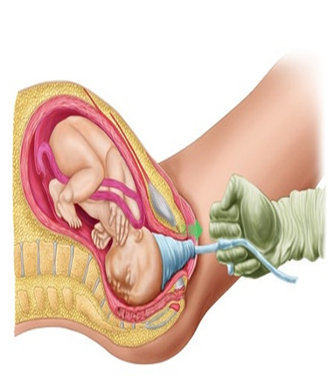
Should these patterns persist even after a change in position, it is advisable to seek guidance from experienced obstetric professionals. In cases where imminent birth is anticipated, the consideration of an episiotomy might be warranted. A midwife trained in ventouse-assisted birth may also be engaged for the delivery.

Slide 12
Progress of Labour
Uterine Contraction
The intensity, duration, and frequency of contractions should be consistently evaluated through observation of maternal reactions and periodically through uterine palpation. Contractions in the second stage of labor typically exhibit greater strength and duration compared to the first stage, often lasting up to one minute with extended intervals of rest between contractions. The maternal posture and position assumed can have an impact on the nature of contractions during this stage.

Slide 13
Descent, Rotation and Flexion
Initially, the descent of the fetus often occurs gradually, particularly in nulliparous women, although acceleration typically take place during the active phase. In multigravida women, descent can occur very rapidly. If there is a delay in descent despite consistent strong uterine contractions and maternal pushing, a vaginal examination may be conducted with the mother's consent.

Slide 14

The objective is to ascertain whether internal rotation of the head has transpired, appraise the station of the presenting part, and ascertain whether a caput succedaneum has developed.

Slide 15
If the occiput has rotated to an anterior position, indicating proper head flexion, progress with the caput formation will likely continue. However, if there's insufficient rotation and flexion, weakened uterine contractions, or a combination of both, it might be advisable to explore options such as changing the woman's position, addressing her nutrition and hydration, or utilizing optimal fetal positioning techniques.
Cont..

Slide 16
Should there be indications of compromised fetal or maternal conditions, it is imperative to seek counsel from an experienced obstetrician.

